Slide 1
SPL-2 Mid-2 Presentation
January 26, 2024

Slide 2
Presented By
Supervised By
ASTRA
Sejuti Sharmin Siddiqui (BSSE 1420)
Nazeeb Ahmed Chowdhury (BSSE 1432)
Mridha Md. Nafis Fuad
Lecturer
IIT, University of Dhaka

Slide 3
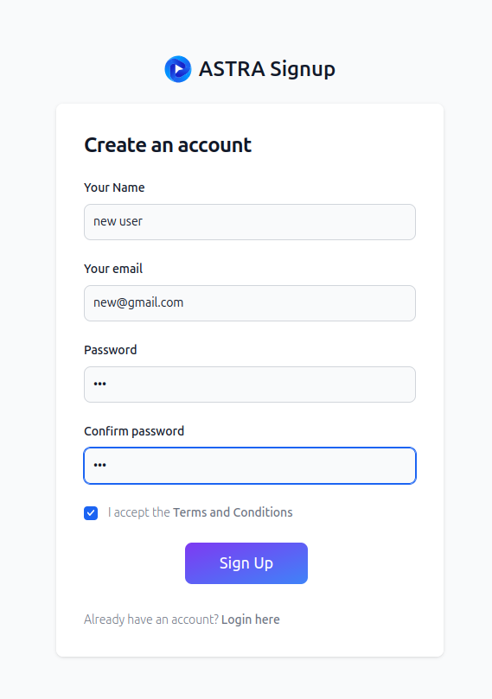
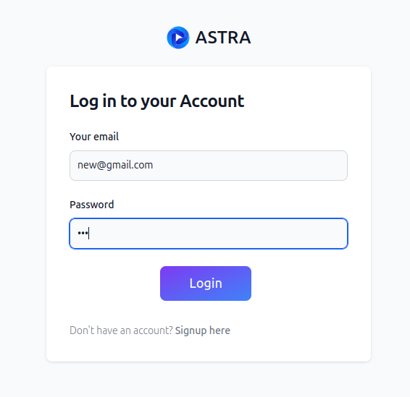
Authentication

Slide 4
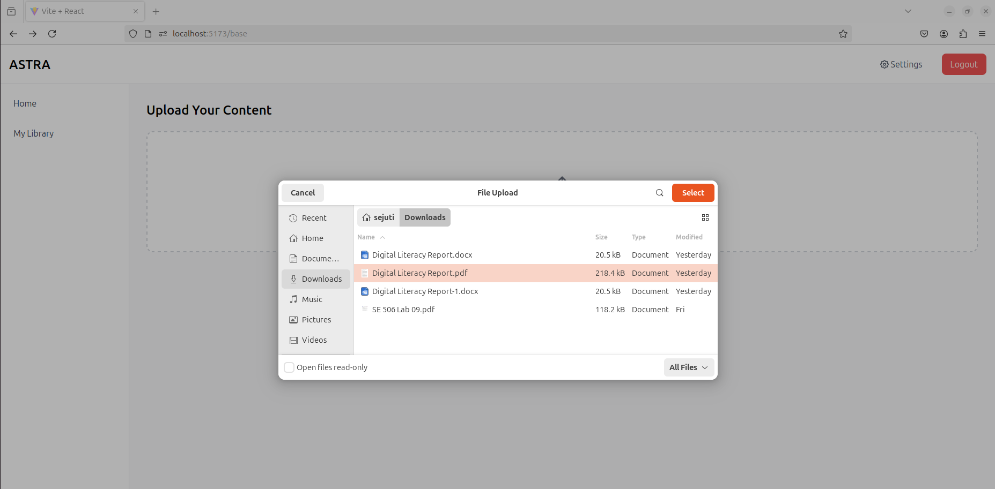
Base Page

Slide 5
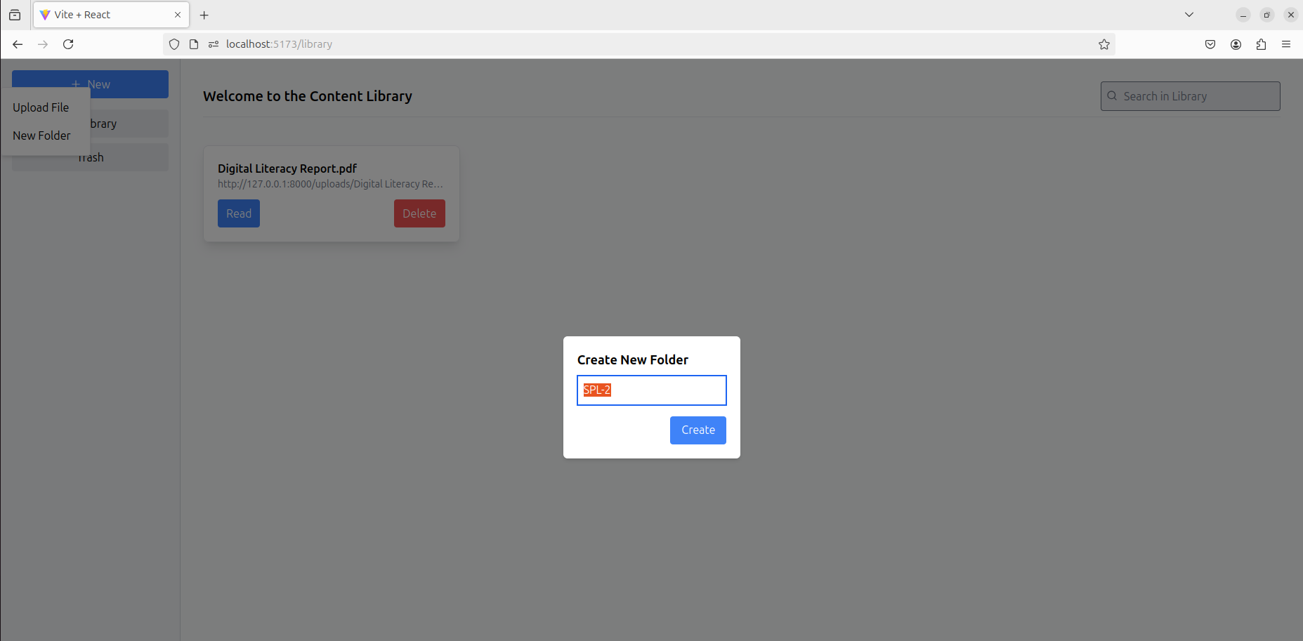
Library Page

Slide 6
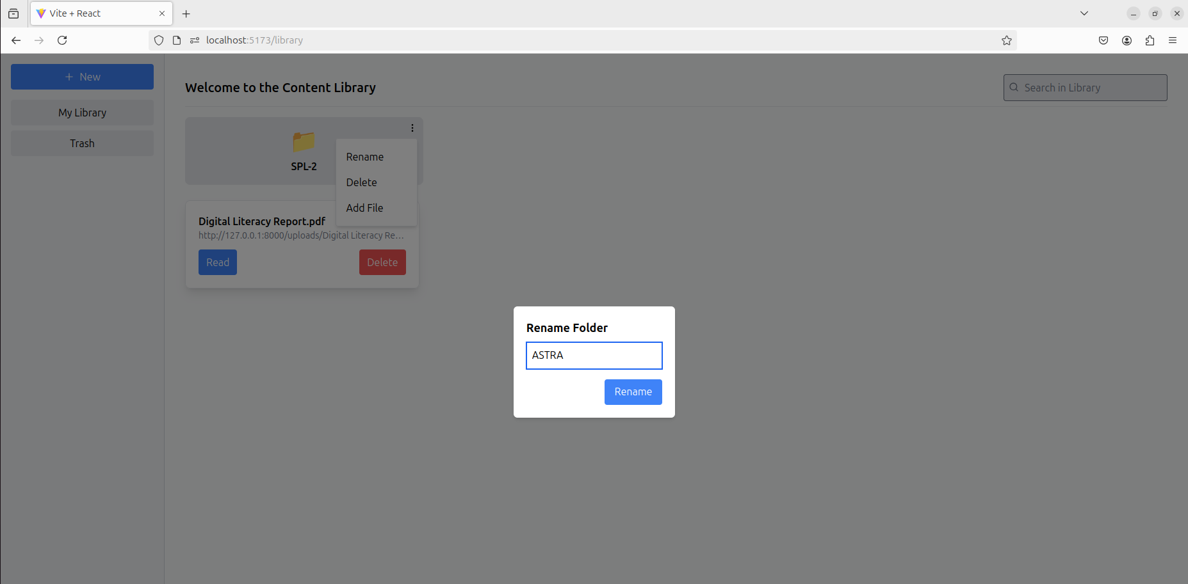
Library Page

Slide 7
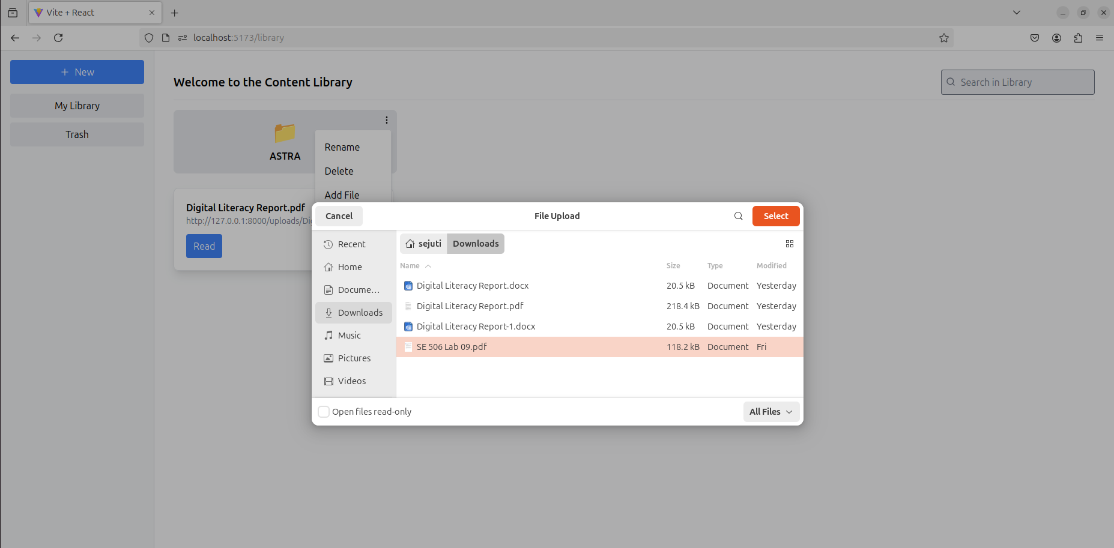
Library Page

Slide 8
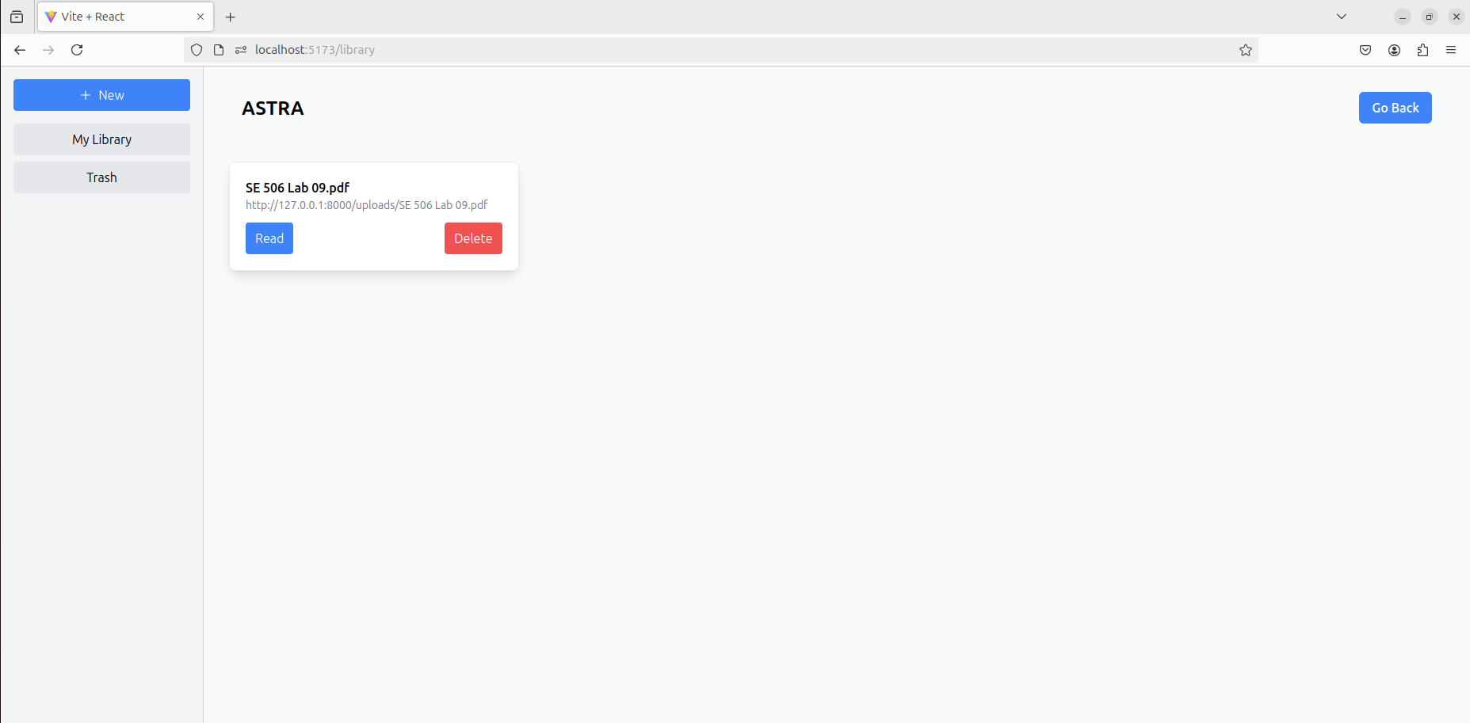
Library Page

Slide 9
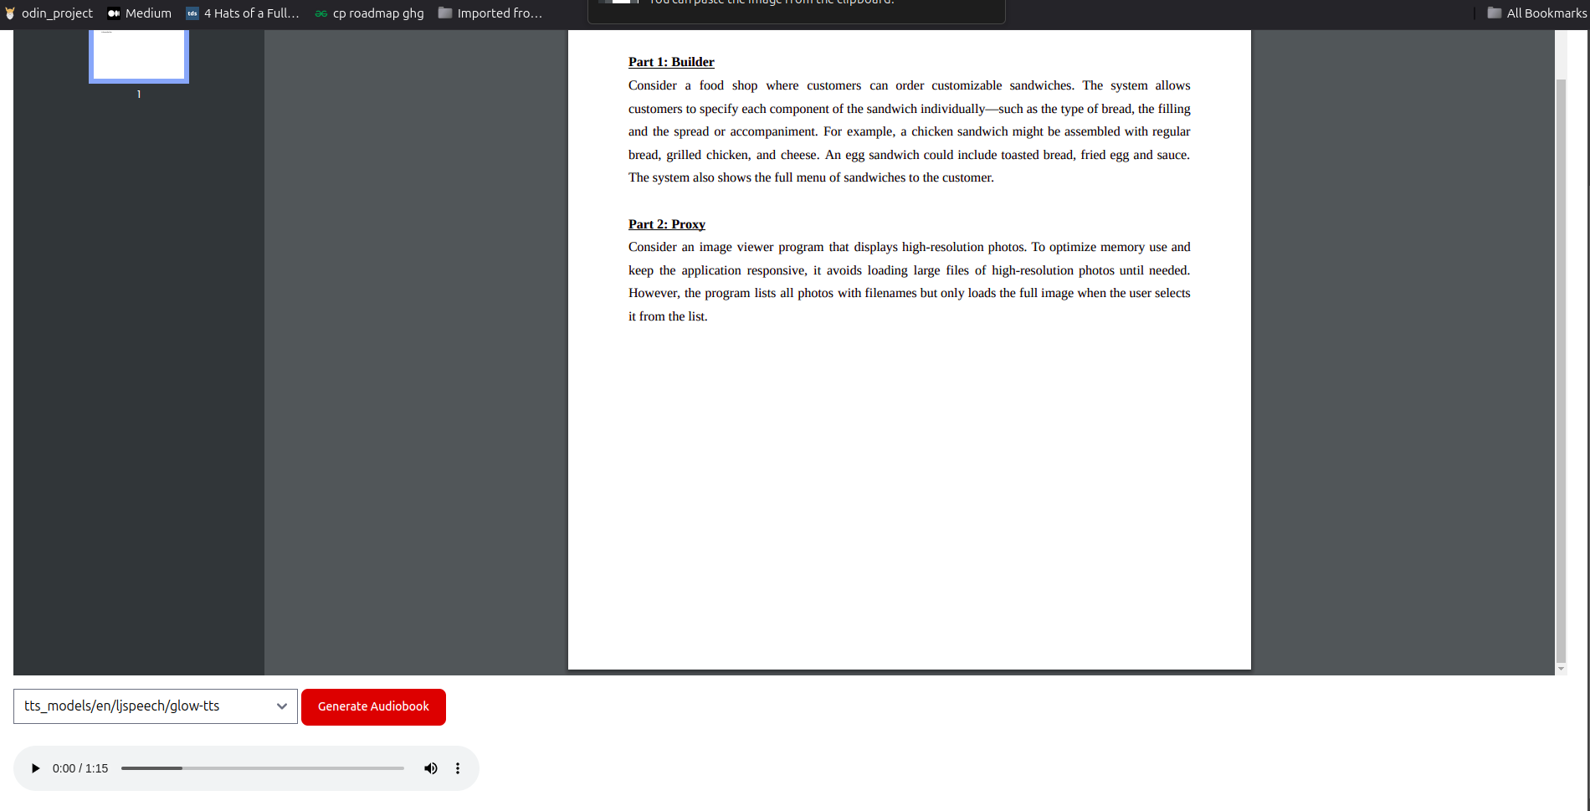
Document Audio Playback

Slide 10
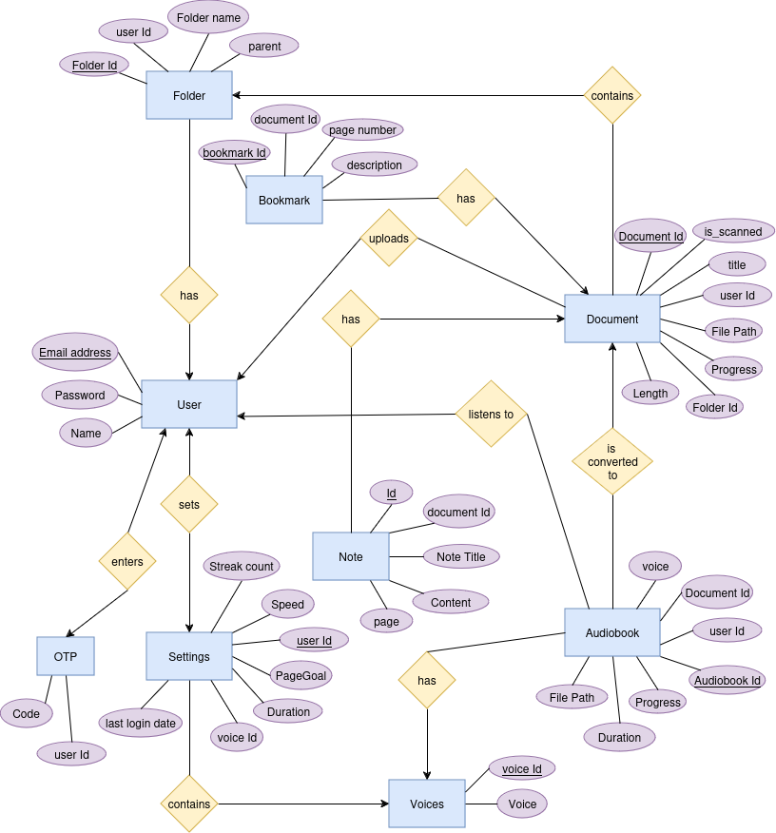
ER Diagram

Slide 11
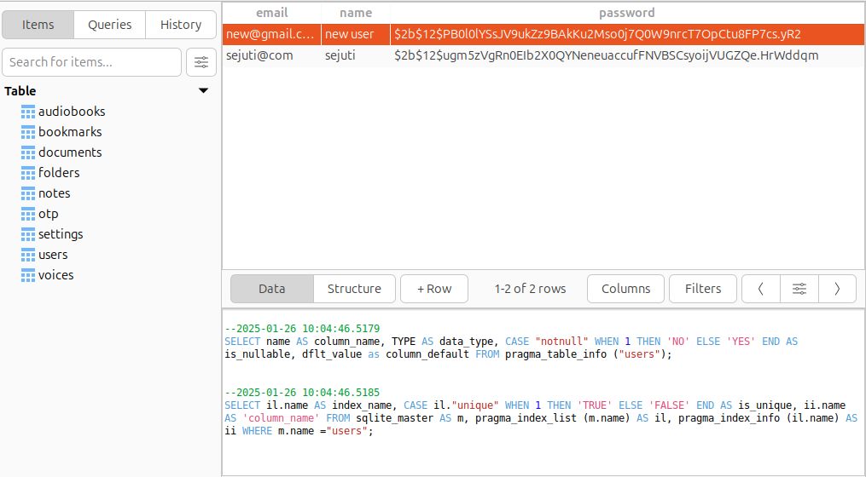
Database Updates

Slide 12
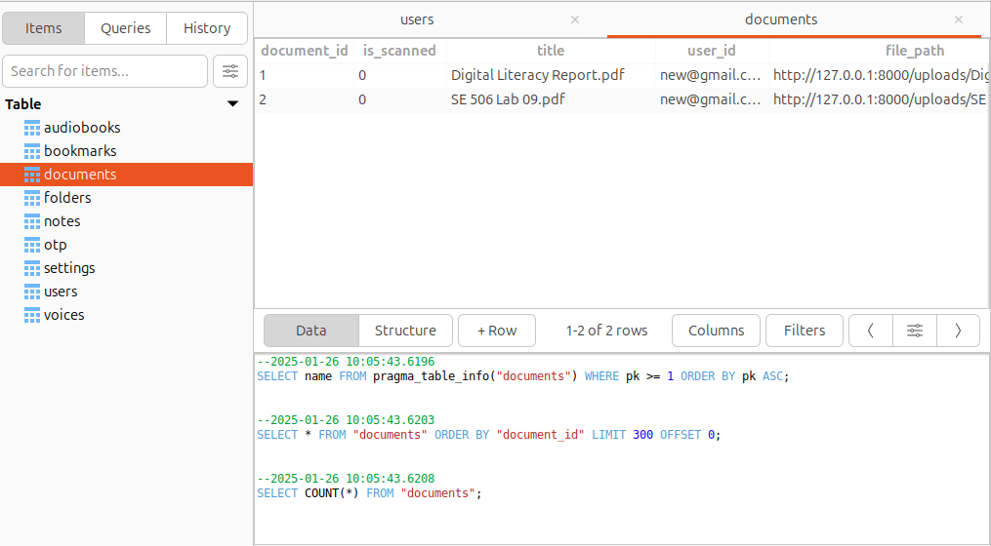
Database Updates

Slide 13
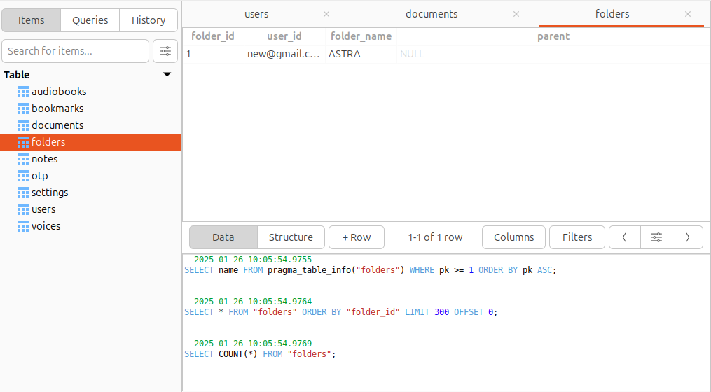
Database Updates

Slide 14
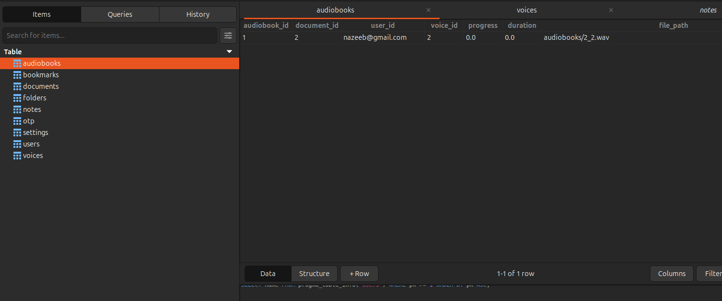
Database Updates

Slide 15
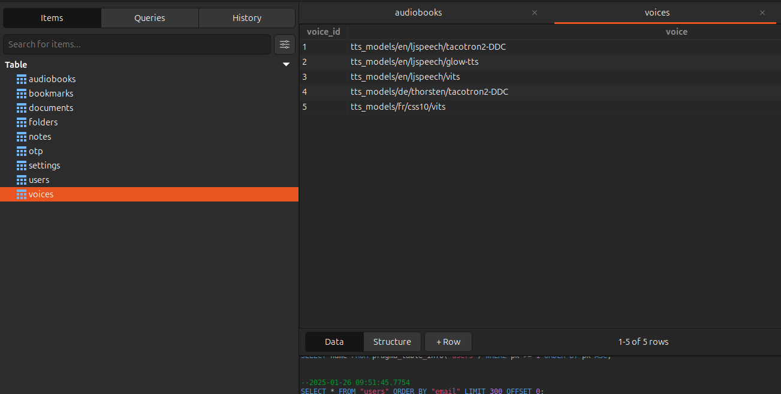
Database Updates

Slide 16
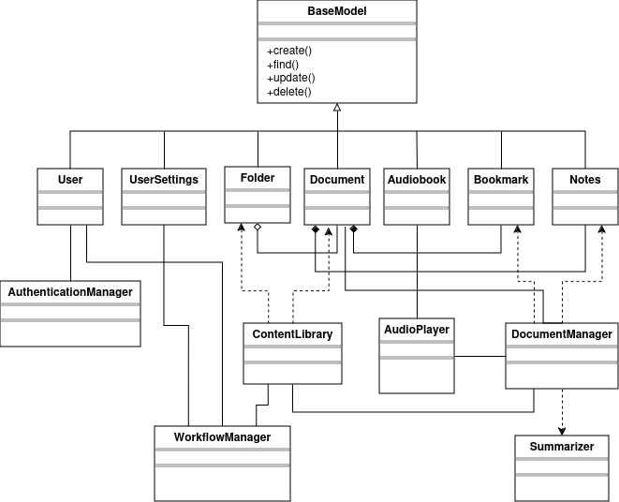
UML Diagram

Slide 17
Thank You!

